Slide 1


.NET core Middleware & Custom Middleware
Bhoomika C.M

Slide 2
What is Middleware?
Middleware is a piece of code in an application pipeline used to handle requests and responses.
A Middleware component can either choose to pass the request to the next component in the pipeline or it may choose to end the request.
Middleware can perform tasks both before as well as after the next component.

Slide 3
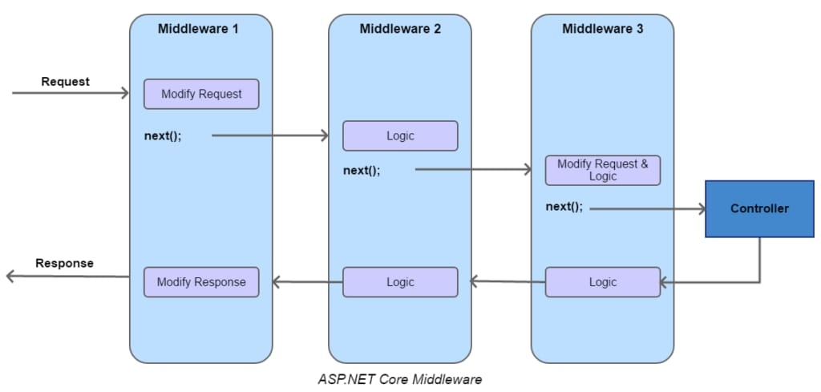
Pictorial representation of Middleware:

Slide 4
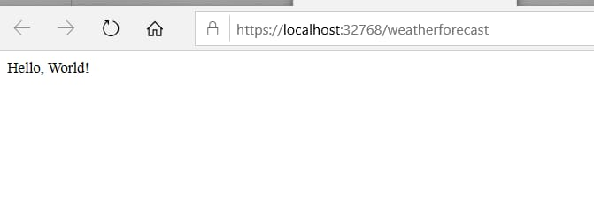
Run():
Code-
Output-
using Microsoft.AspNetCore.Builder;
using Microsoft.AspNetCore.Hosting;
using Microsoft.AspNetCore.Http;
using Microsoft.Extensions.Hosting;
namespace Middleware. Demo
{
public class Startup
{
public void Configure(IApplicationBuilder app)
{
app.Run(async context =>
{
await context.Response.WriteAsync("Hello,World!");
});
}
}
}

Slide 5

Use():
Code-
Output-
namespace Middleware.Demo
{
public class Startup
{
public void Configure(IApplicationBuilder app)
{
app.Use(async (context, next) =>
{
await context.Response.WriteAsync("Hello, World!");
await next();
});
app.Run(async context => {
await context.Response.WriteAsync("Another Hello, World!");
});
} } }

Slide 6

Map():
Code-
Output-
namespace Middleware.Demo
{
public class Startup
{
public void Configure(IApplicationBuilder app)
{
app.Map("/newbranch", a => a.Run(c => c.Response.WriteAsync("Running from the newbranch branch!")));
app.Use(async (context, next) => {
await context.Response.WriteAsync("Hello, World!");
await context.Response.WriteAsync("<br>This is after another Hello, World!");
});
app.Run(async context => {
await context.Response.WriteAsync("<br>Another Hello, World!");
});
} } }

Slide 7

Custom Middleware

Slide 8
Code-
using Microsoft.AspNetCore.Builder;
using Microsoft.AspNetCore.Hosting;
using Microsoft.AspNetCore.Http;
using Microsoft.Extensions.Hosting;
namespace Middleware.Demo
{
public class Startup
{
// This method gets called by the runtime. Use this method to configure the HTTP request pipeline.
public void Configure(IApplicationBuilder app)
{
app.UseCustomExtension();
app.Run(async context =>
{
await context.Response.WriteAsync("<br>Another Hello, World!");
});
}

Slide 9
Code- To create a new custom middleware
using Microsoft.AspNetCore.Http;
using System.Threading.Tasks;
namespace Middleware.Demo
{
public class CustomMiddleware
{
private readonly RequestDelegate next;
public CustomMiddleware(RequestDelegate next)
{
this.next = next;
}
public async Task Invoke(HttpContext httpContext)
{
await httpContext.Response.WriteAsync("Inside of new custom middleware");
await next(httpContext);
}}}

Slide 10
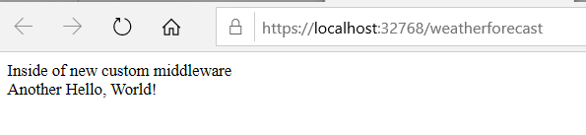
using Microsoft.AspNetCore.Builder;
namespace Middleware.Demo
{
public static class MiddlewareExtension
{
public static void UseCustomExtension(this IApplicationBuilder app)
{
app.UseMiddleware<CustomMiddleware>();
}
}
} Output:

Slide 11

Thank You

